Slide 1
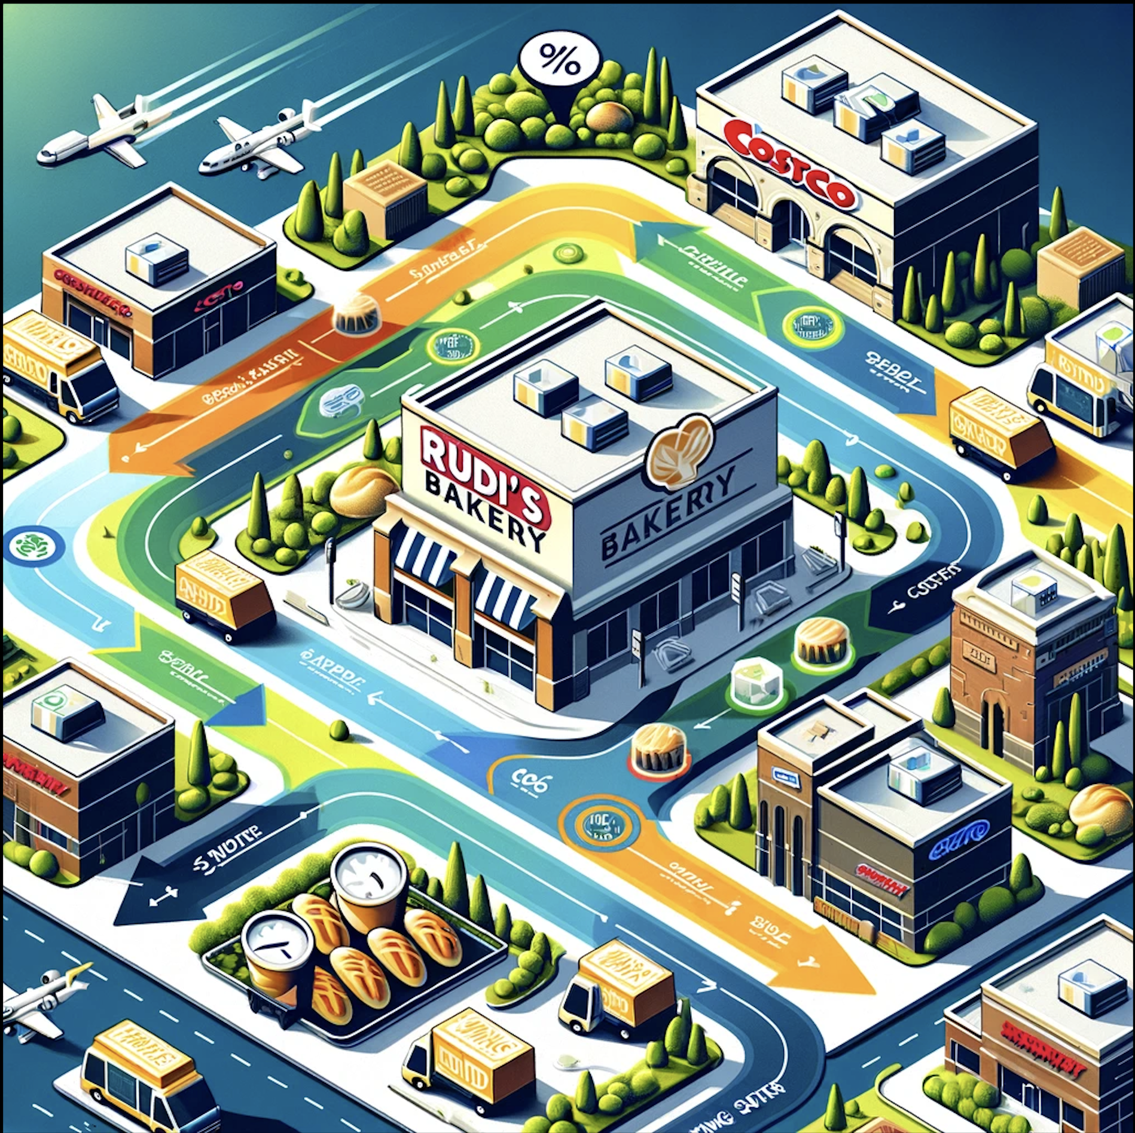

RouteMax
Route optimization for Rudi’s
Presentation by :
Harshit Gole, Kirti Vatsh
Charles Biddle Porter, Duc Hoang
Manan Dhanteja

Slide 2

Mission
Optimize two delivery routes for Rudi's Bakery originating from Colorado Springs.
Total of 53 stores, including the depot.
Objective: Segregate stores into two routes.
Goals: Maximize service points and reduce delivery time.

Slide 3
Literature Survey
Sources | Optim. Model | Software | Relevance
Multi-obj VRP | Delivery time | Gurobi Optimizer | Feasible, best
Inventory Mgmt | Dynamic prgmg | Custom-made | Needs budget
VRP time window | Time constraints | OptaPlanner | Infeasible
Heuristics v. VRP | Min. transport cost | Excel Solver | Limited ability
Ant Colony Optim | Incr. Cust. Sales | Google API | Infeasible
Grocery LMD | Vehicle capacity | Paragon | Infeasible

Slide 4


Software Choices
Google API
Gurobi
Premier optimization package, perfect for the task
Google Colabs
Eliminates processing needs on local computer through cloud computing options
Easy to share

Slide 5

Data Cleanup and Google API
Verified addresses and added Zip Codes
Google Maps API used to populate a time matrix between each address
Added unloading times to each time
Random sample of 20 arcs taken to verify travel times.
Assigned Unique Identifiers to the Addresses .
Notes:
Charles from here

Slide 6

Model
Goal : Develop an efficient and easy to use model
Excel file setup is the backbone
What makes a good model?
Dynamic, adjustable assumptions
Nothing hard coded
Easy to interpret
Functionality
Smaller learning curve
Model runs efficiently without requiring extensive processing power

Slide 7
Clustering and Visual Mapping
Initial model versions were infeasible
Action: create a dummy data set for development and testing of model
Result: Reduce computational load and complexity of the model
Visually Mapped
Created clusters, combining data points for Castle Rock and Pueblo clusters
Set entry points, clear they would all be visited on same day
Assigned all data points to one of three groups:
North Route and South Route for those that were easily separable
Unassigned for the remaining

Slide 8
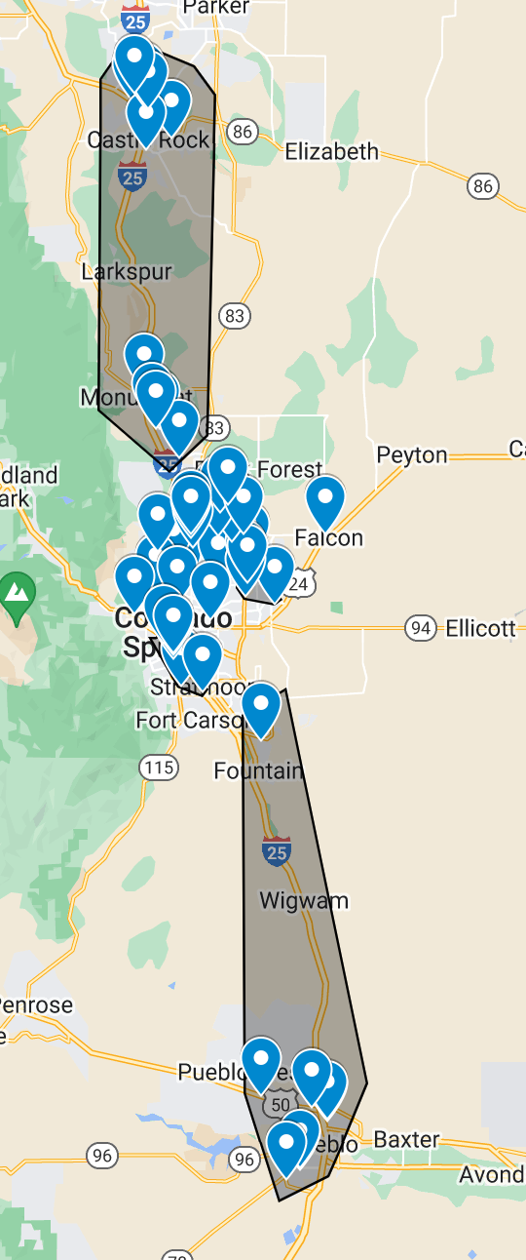
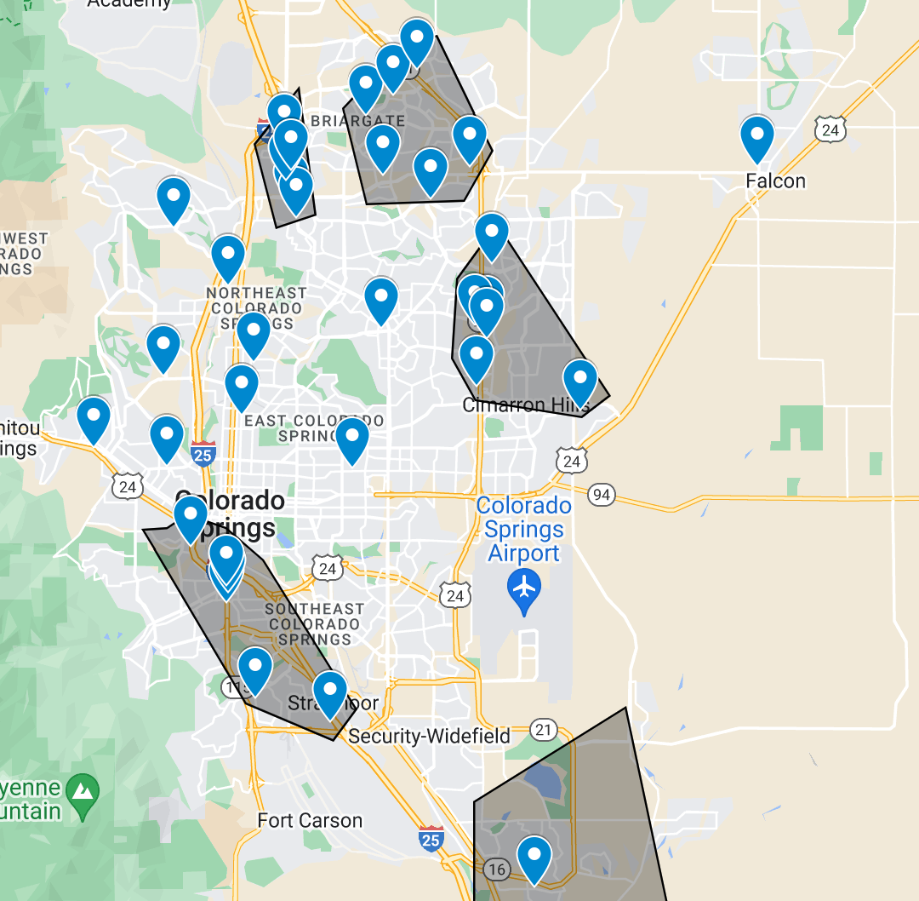
Visual Mapping

Slide 9
Gurobi
Optimization Software: Gurobi solves linear and mixed-integer problems, suited for logistics and transportation.
Python Integration: Offers seamless integration with Python, enabling straightforward problem modeling and solution finding, enhancing its usability.
Route Optimization: Utilizes advanced algorithms and high-speed computations for route optimization, effectively minimizing travel times or distances under complex constraints, leading to cost savings and enhanced operational performance.

Slide 10
Set Up for Rudi’s
Constraints
Depot is the start and end point.
Service Costco everyday.
All stores visited at least 3 days a week (Special 4 times/week)
No 3 consecutive day delivery.
Duration for both routes to be less than 9 hours.
Stores once assigned to one route cannot be changed.
Objective Function
Minimize time taken to complete service to stores
Decision Variables
Stops assigned to origin and destination
Stops are assigned to days

Slide 11
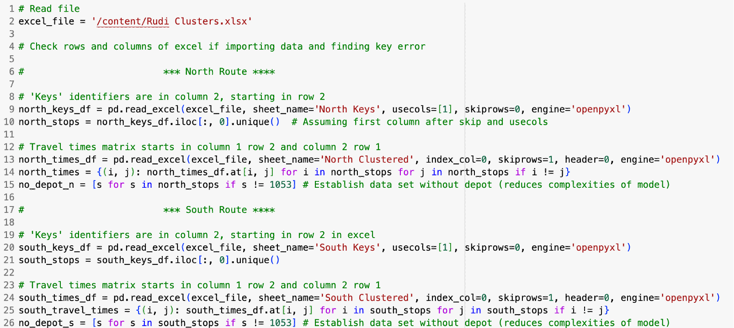
Data import/Model Set Up
Excel file segments routes ahead of model

Slide 12
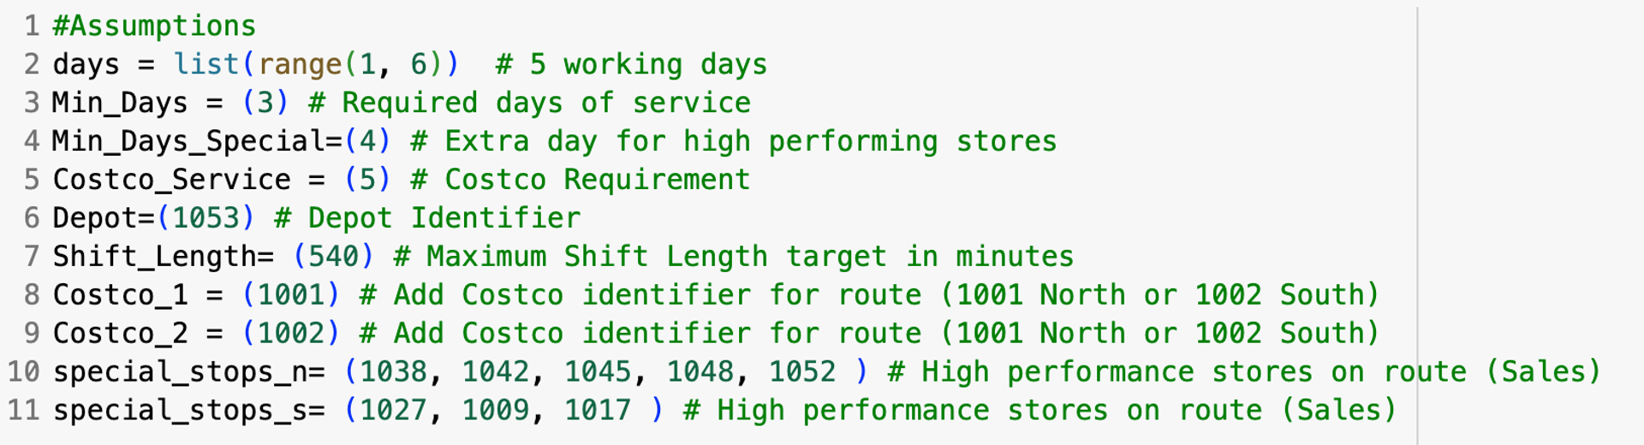
Model Core

Slide 13
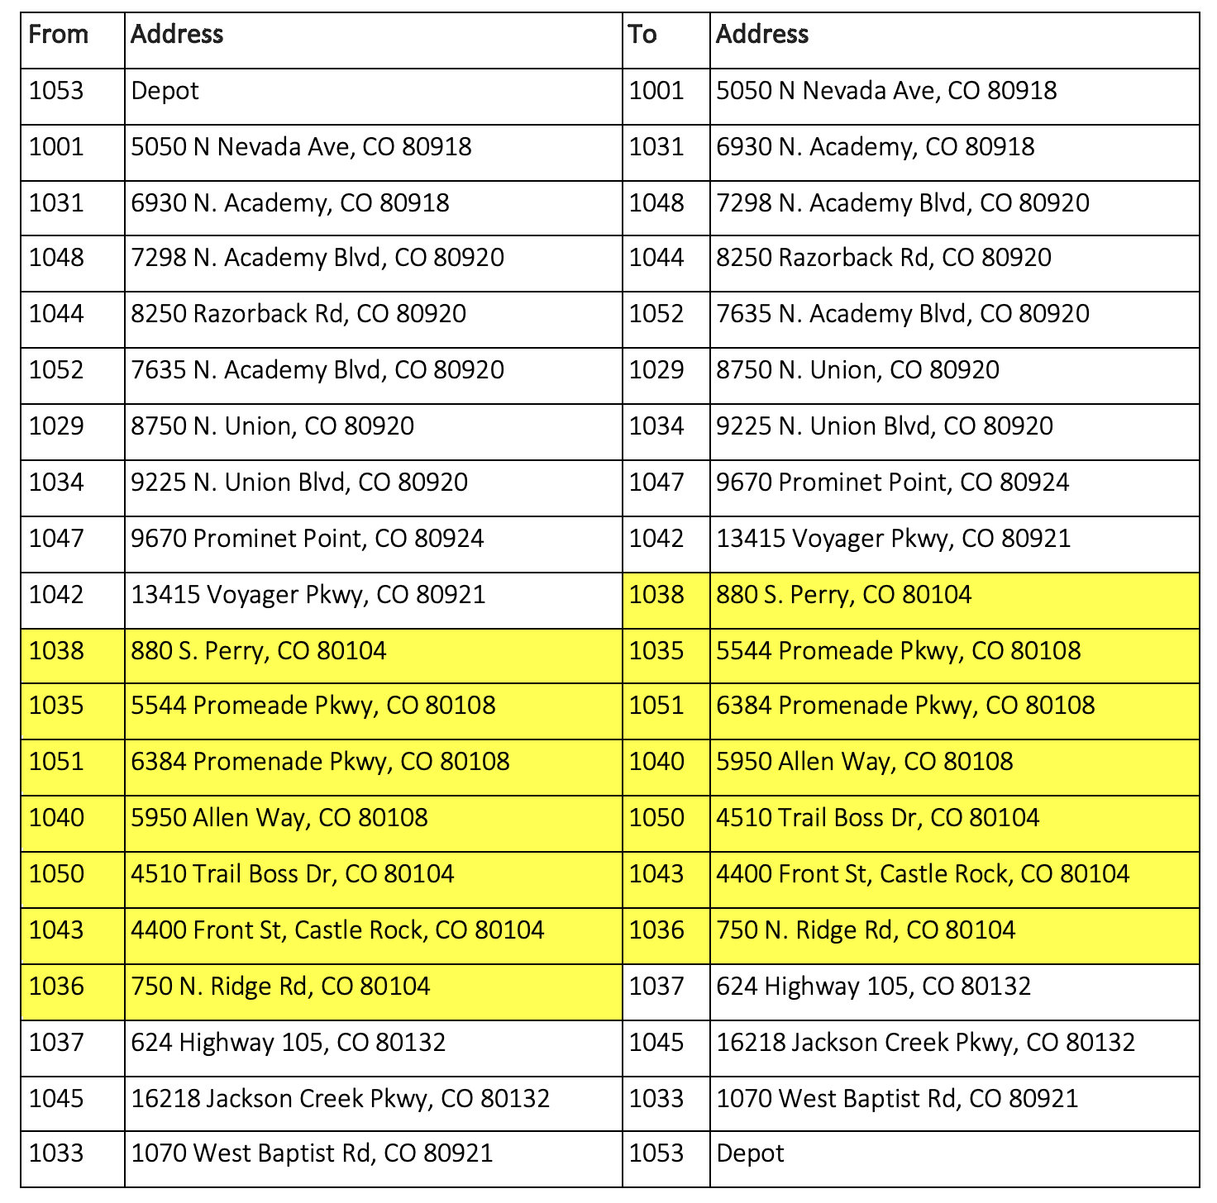
Output
Clear Route with each stop for each day.
Total Travel time each day.
Average: 7 hrs 45 mins / day
 | North Route (minutes) | South Route (minutes)
Day 1 | 478 | 466
Day 2 | 438 | 466
Day 3 | 477 | 462
Day 4 | 476 | 466
Day 5 | 479 | 463
*Yellow highlight represents Castle Rock cluster

Slide 14
Key Performance Indicators (KPIs)
KPI Description | KPI characteristic | Achieved
Percentage of delivery days that takes less than 9hrs/day | The higher the better | 100%
Percentage of number of service days for Costco over a week (5 times per week) | The higher the better | 100%
Percentage of number of non-costco stores served more than 3 times/week | The higher the better | Route 1: 115.28% Route 2: 111.54%
Percentage of stores served 3 days in a row in a week | The lower the better | 0%
Maximum deviation between the actual and achieved delivery time w.r.t. achieved delivery time. | The lower the better | 10%

Slide 15
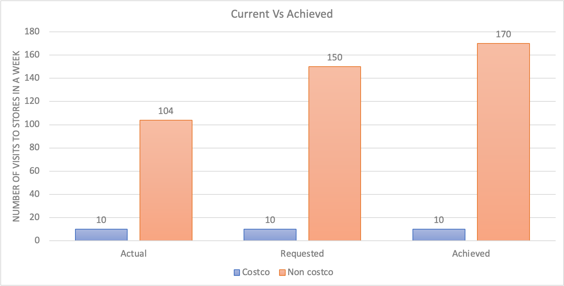
Current Vs Achieved
Notes:
harshit

Slide 16
Model Next Steps
Introduce weighting and dynamic assignment of stores based on overall sales performance.
Replace current method of selection
Maximise revenue under constraints
Would lead to more uniformity in shift length

Slide 17
Model Next Steps
Introduce weighting and dynamic assignment of stores based on overall sales performance
01
Replace current method of selection
02
Revenue maximization under constraints
03

Slide 18
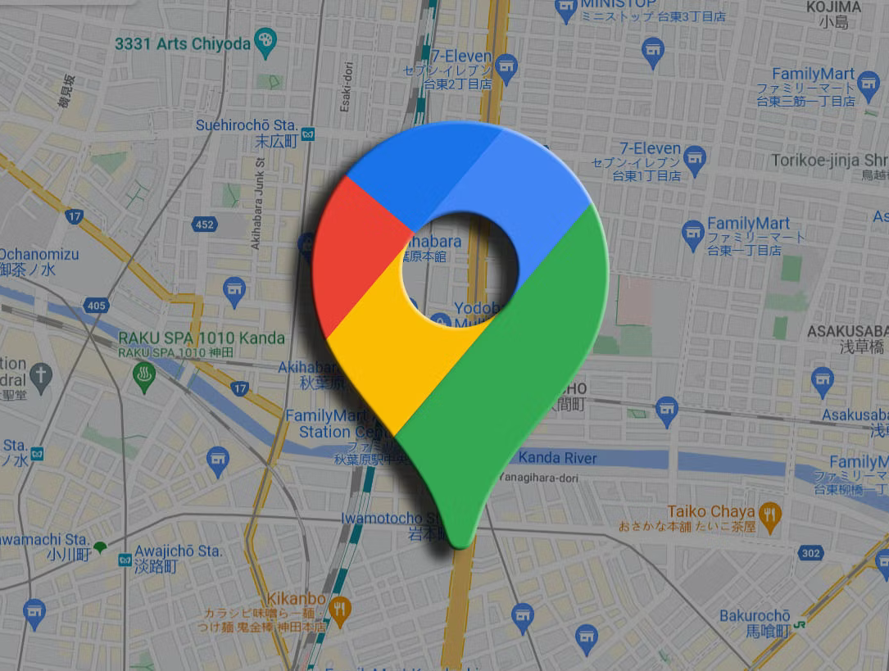
Conclusion
Optimized model that meets the requirement and improves service.
All KPIs met.
Opportunity to adjust model based on revenue maximization
Rudi’s now have optimized delivery routes

Slide 19


